Slide 1

Diet clinic
A Project by:
Tanzeel Ur Rehman (345510),
Ali Raza Dar (343375),
Raja Haider Ali O(346900).

Slide 2
Project Description
The project is a website of an already existing clinic.
Nowadays, almost every business is going online, so to cater with the changing world website is necessary.
The website is acting as a virtual clinic providing all the necessary functionalities, available in a clinic.
The client can login into the account, can choose different diet programs, can see blogs and videos regarding diet plans and can also give their valuable feedbacks regarding the website.
They can also contact their dietitian through the contact option available in the website.

Slide 3
System purpose
This is the first draft of the System Requirement Specification (SRS) for the Website named “Diet Clinic”. This document is written in accordance with rules issued by IEEE for SRS.
Diet Clinic is a private organization which sell diet plans to their customers. The organization already have social media presence on Instagram and Facebook. By owning a website, the organization can further increase its audience by providing a virtual clinic, where customers can interact with dietitian and get information about a healthy lifestyle.
By using this website, customers will be able to book their appointment with dietitian just by clicking a button and can get motivations by reading blogs about health and nutrition to improve their lifestyle. The website will also provide an online monitoring system which will show weekly, and monthly progress to customers.

Slide 4
system scope
The website will act as an online platform for the clinic. It will provide the same features available in a physical clinic. The customer will get register on the website and his whole progress will be saved in an account through which he will be able to manage his entire diet programs. Customers will be able to book virtual appointment and will be able to resolve their queries through an online chat box which will be active 24/7. Furthermore, website will have different blogs which will have real-time success stories and information about “how to life a healthy lifestyle”, to motivate the customers and enhance their knowledge.

Slide 5
Project Implementation
The project has been created using the following programming languages:
Html,
CSS,
JavaScript,
Php.

Slide 6
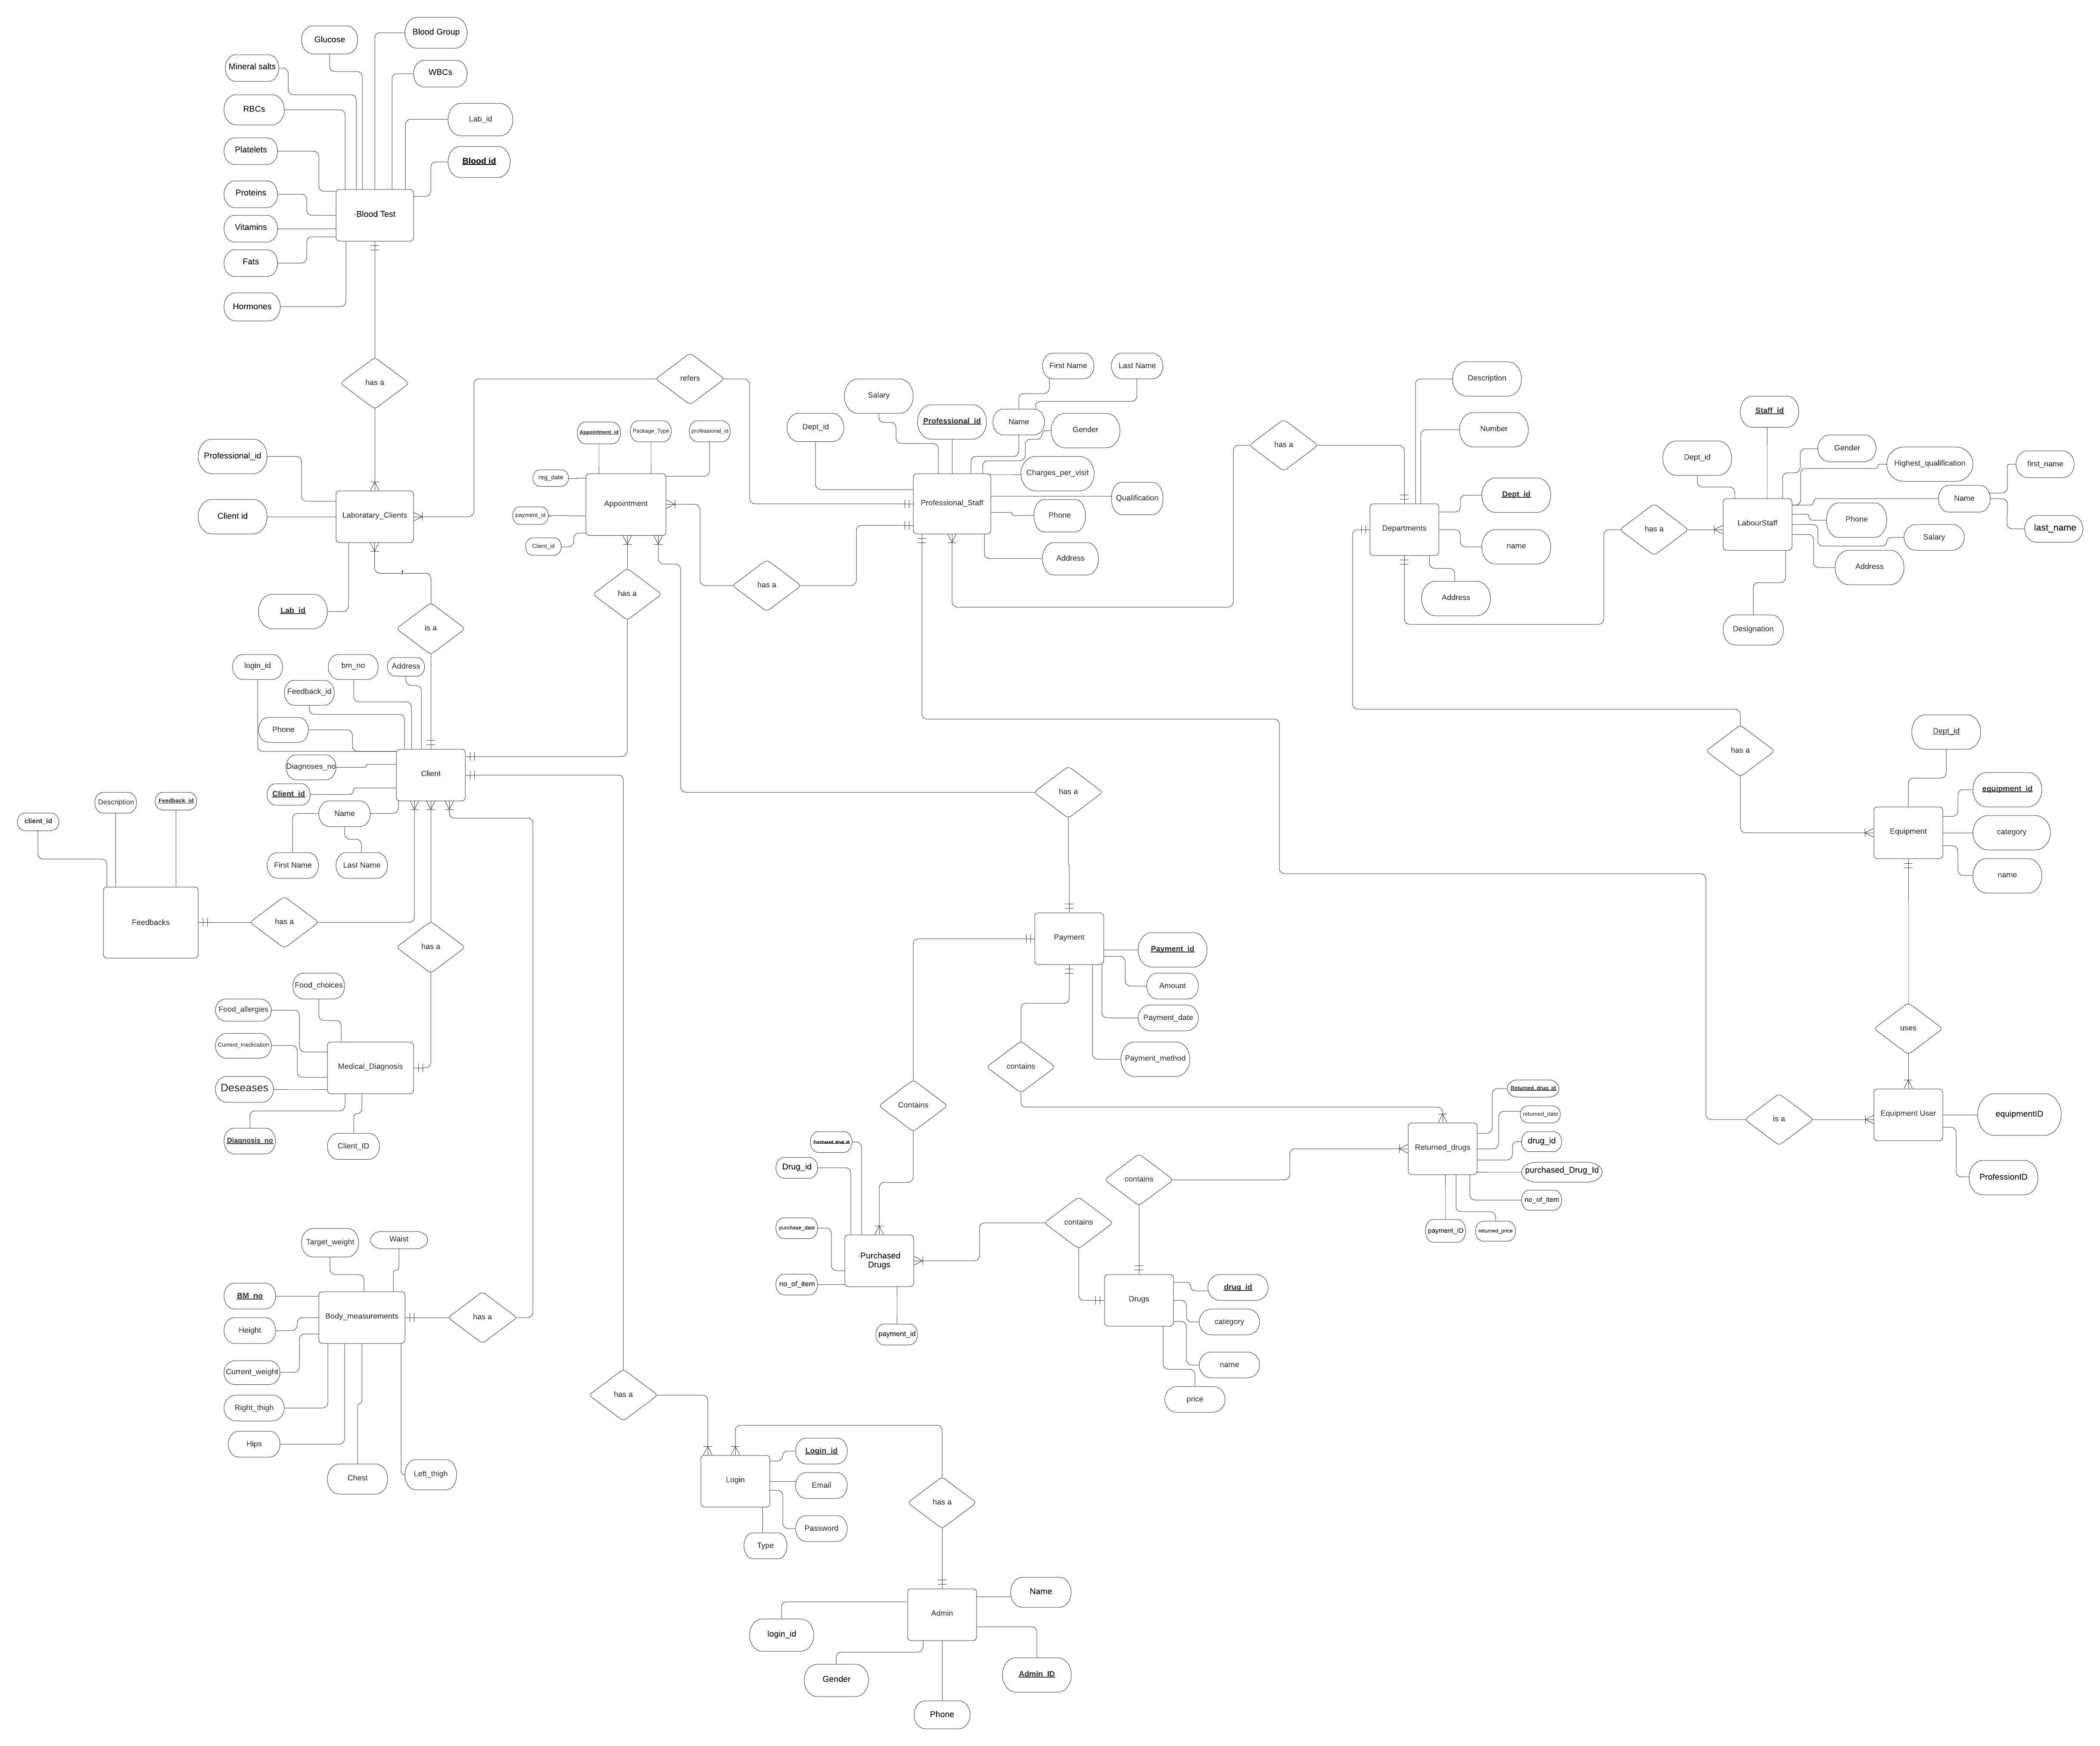

Slide 7
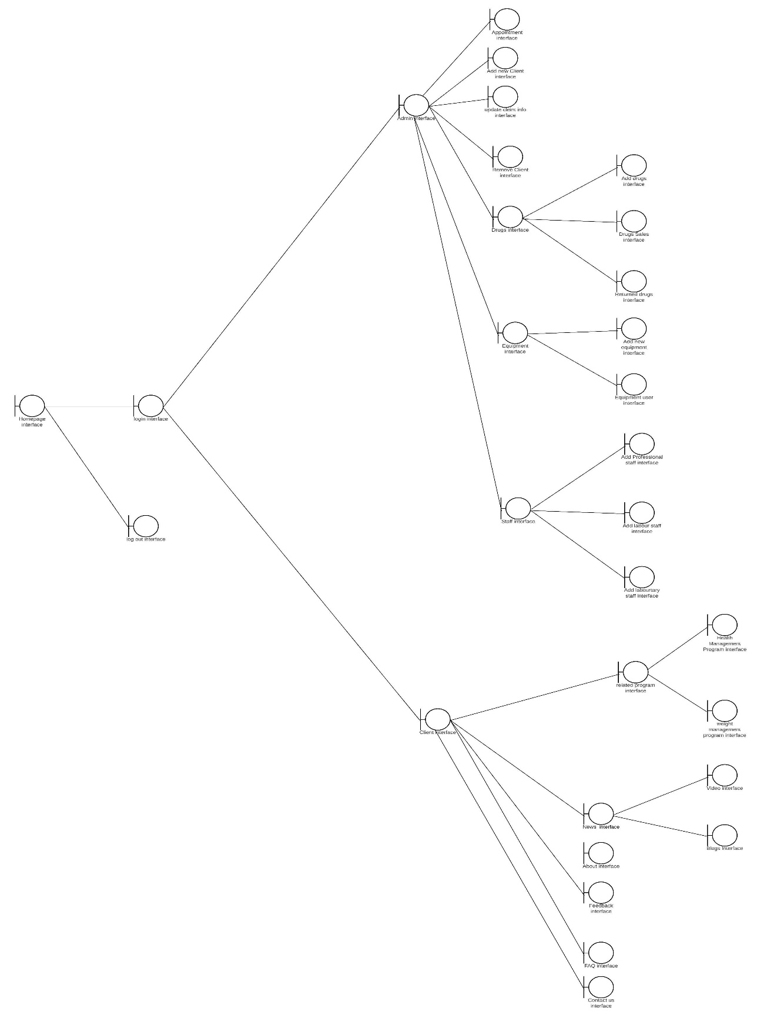

Interface system diagram

Slide 8
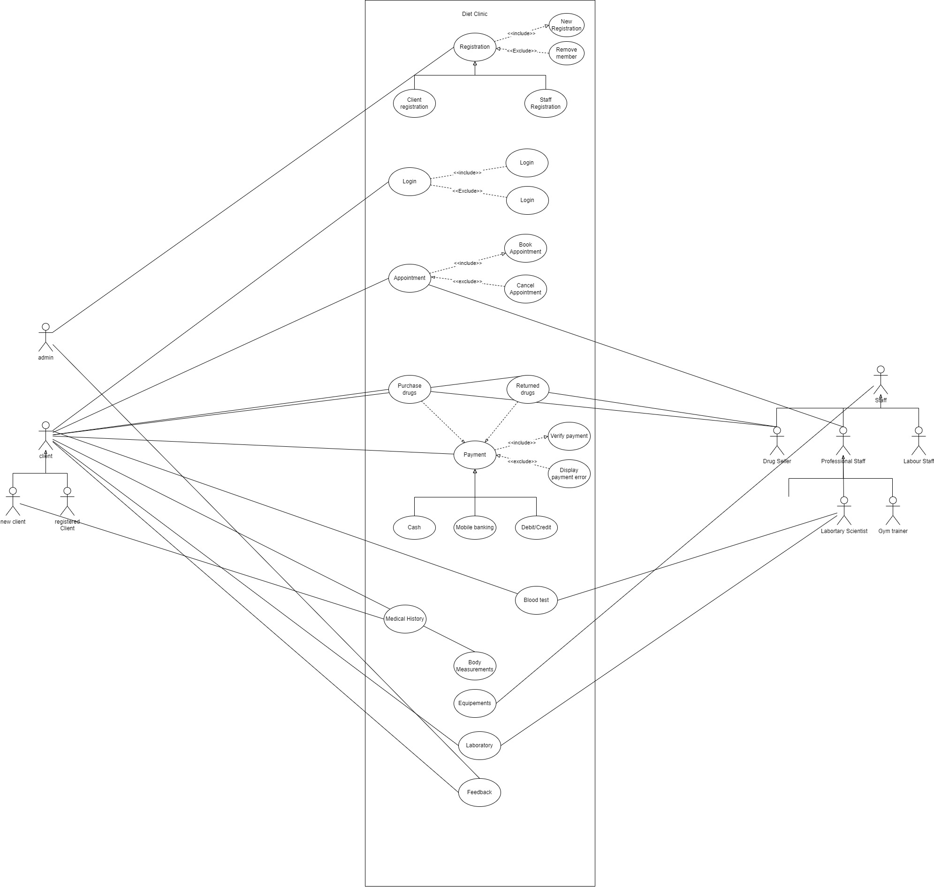
Usecase diagram

Slide 9
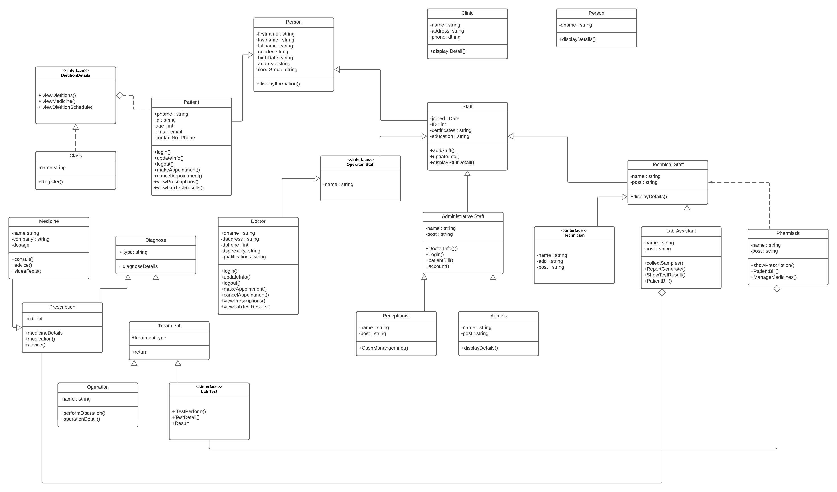
Class diagram

Slide 10
PROJECT DEMO

Slide 11
GitHub Link
https://github.com/KhawajaTanzeelUrRehman/Diet-Clinic

Slide 12
THANK YOU

